Slide 1
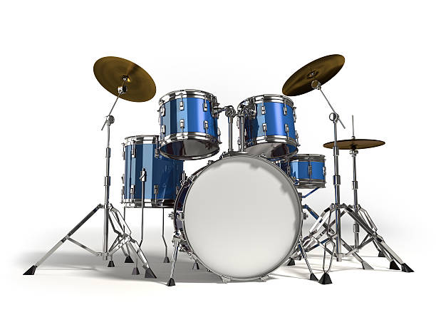

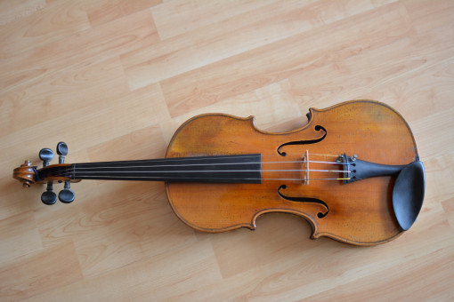

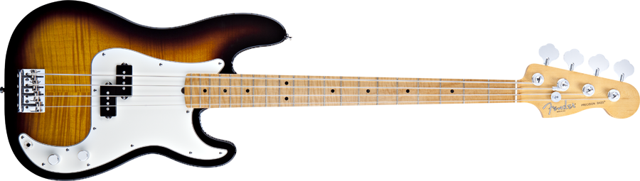
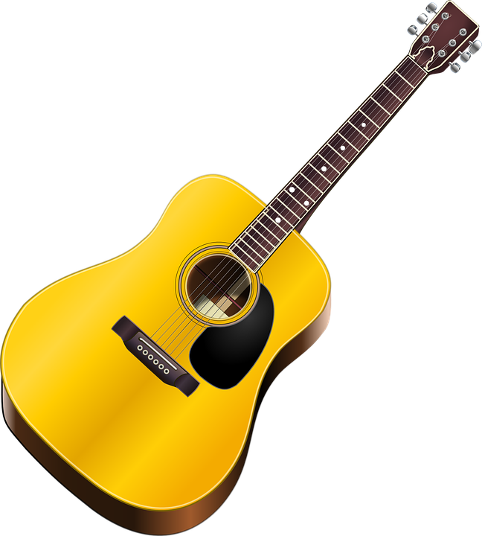
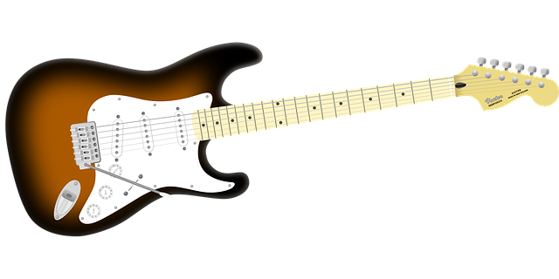
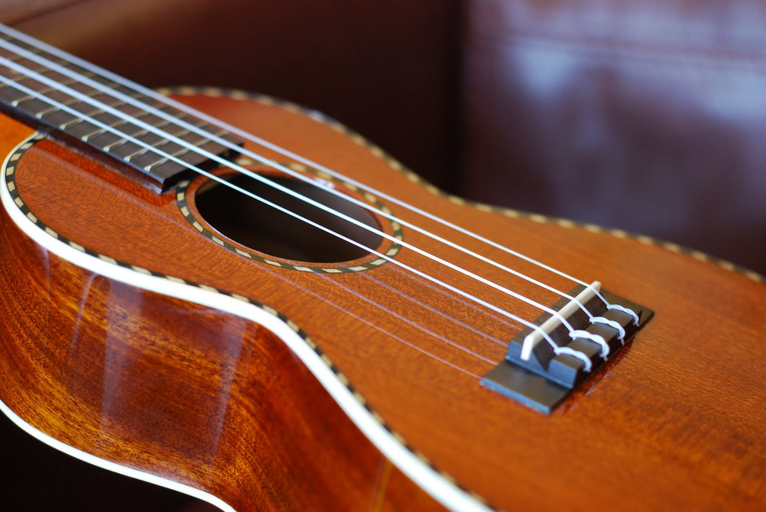
Bedlam Station – Stage Plot
Auxilary
Instrument(s)
(1/4” or XLR)
Snare Mic
(XLR)
Keyboard
(1/4”)
Vox Mic 6
(XLR)
Vox Mic 5
(XLR)
Kick Mic
(XLR)
Bass
Guitar (XLR)
Ukulele
(1/4”)
Acoustic
Guitar (XLR)
Electric
Guitar (XLR)
Vox Mic 3
(XLR)
Vox Mic 4
(XLR)
XLR Vox | 6
XLR Instruments | 6
1/4" Instruments | 2
TOTAL | 14
Vox Mic 2
(XLR)
Vox Mic 1
(XLR)

